Slide 1
Blood

Slide 2
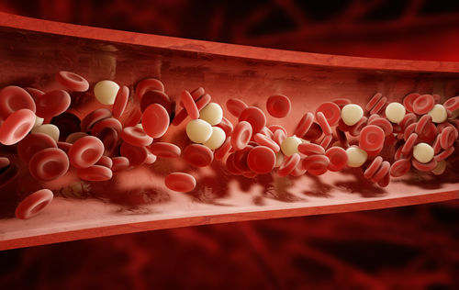
By the end of this Lesson you should be able to:
1. | State the function of red blood cells.
2. | State the function of white blood cells.
3. | Describe what plasma is.
4. | State the function of platelets.

Slide 3
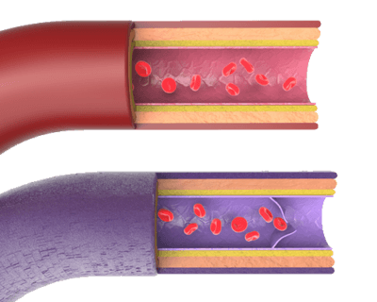
The Blood
The blood is how nutrients, wastes, oxygen and carbon dioxide are transported throughout the body.

Slide 4
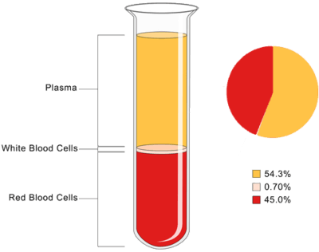
Blood is essentially made up of cells suspended in a liquid.
A liquid called plasma makes up just over half (almost 55%) of the content of blood. Red blood cells make up close to 45%, and white blood cells make up less than 1% of blood volume.

Slide 5
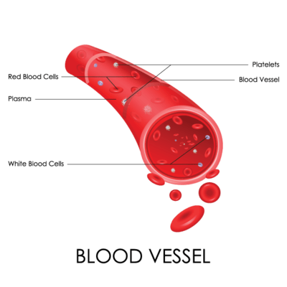
Blood is made up of cells suspended in plasma.
There are three types of blood cells. These are:
1. | Red blood cells.
2. | White blood cells.
3. | Platelets

Slide 6
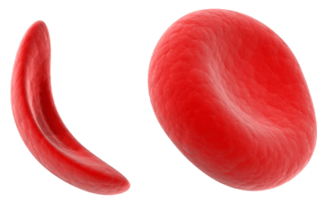
Red blood cells are what gives blood its red colour.
They are the shape of a donut, but instead of a hole in the middle, there is just a small indent. This is often described as a biconcave disc.
Red blood cells are unusual, because they have no nucleus. This allows them to carry more oxygen molecules.

Slide 7
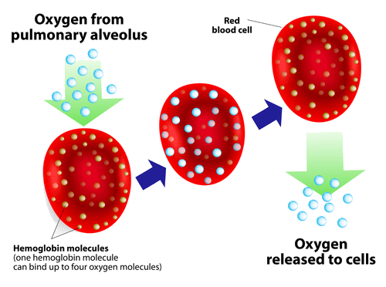
The function of red blood cells is to carry oxygen around the body.
To do this, they contain a special pigment called haemoglobin. This is what makes them red.
When red blood cells receive oxygen at the lungs, it binds to the haemoglobin, forming oxyhaemoglobin.

Slide 8
White blood cells are a lot less common than red blood cells.
They are part of our immune system and work together to fight disease by engulfing (eating) harmful bacteria, keeping us healthy.

Slide 9
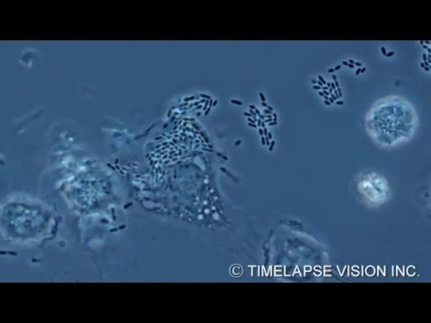

Slide 10
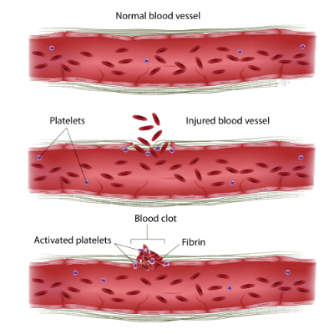
Platelets are fragments of cells.
They help our blood clot.
Too few platelets and we wouldn't stop bleeding.
Too many and our blood would clot in our blood vessels. This is the cause of heart attacks and strokes.

Slide 11
